Slide 1


PRESENTATION
TECHHERO
TEAM MEMBERS:-
ANJALI KUMARI (201500095)
NAINA JOHRI (201500422)
SHUBHI AGARWAL (201500682)

Slide 2
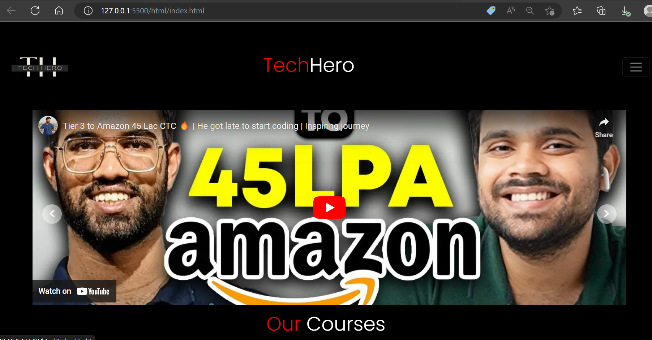
Home page
For any website the home page plays a crucial role as it tells the motive of the website.
In this website we have used an image carousel which have some interview experiences of some who are placed at high packages.

Slide 3
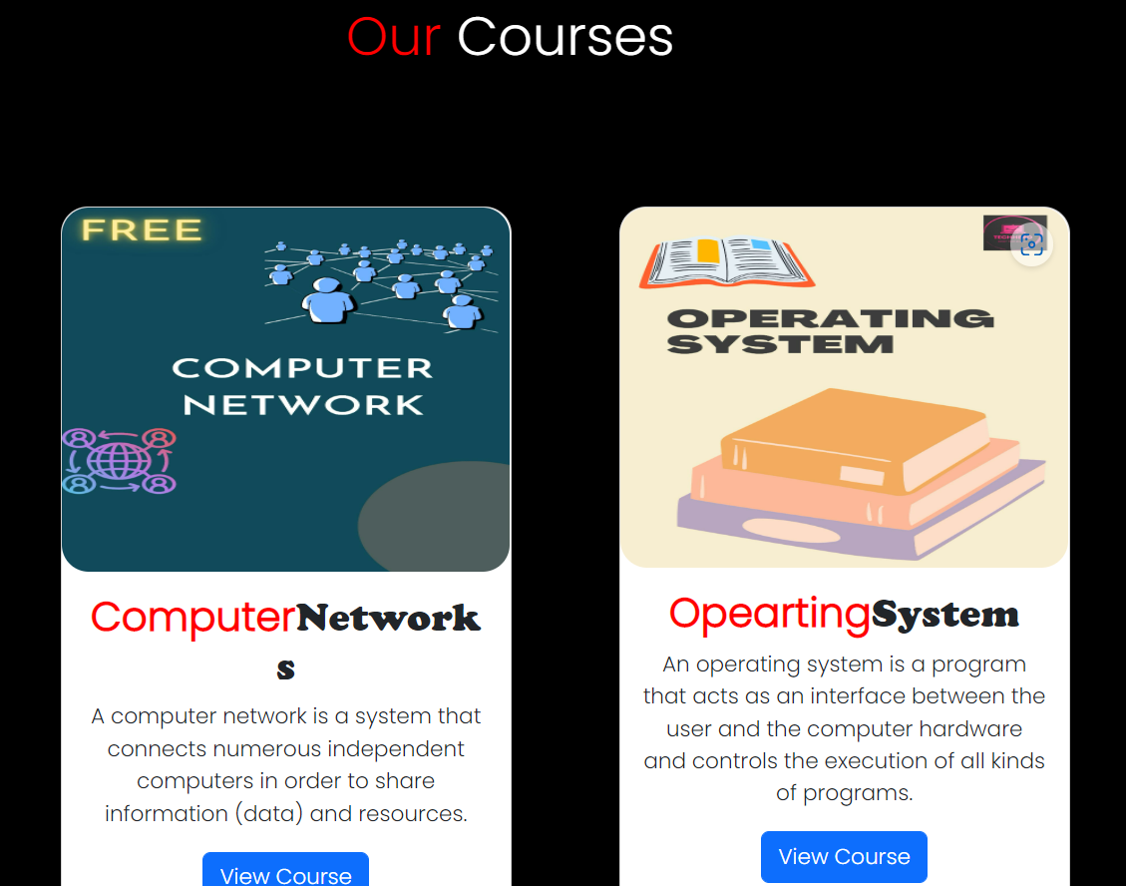

Courses
Here we have added some of our courses which consist notes of module1 and module2.

Slide 4

Coming Soon
Here are some of our upcomming courses.

Slide 5

BootCamp
Here we have provided Bootcamp of React which is of 5 days .
By clicking on GetInfo you can get information regarding ReactBootcamp

Slide 6
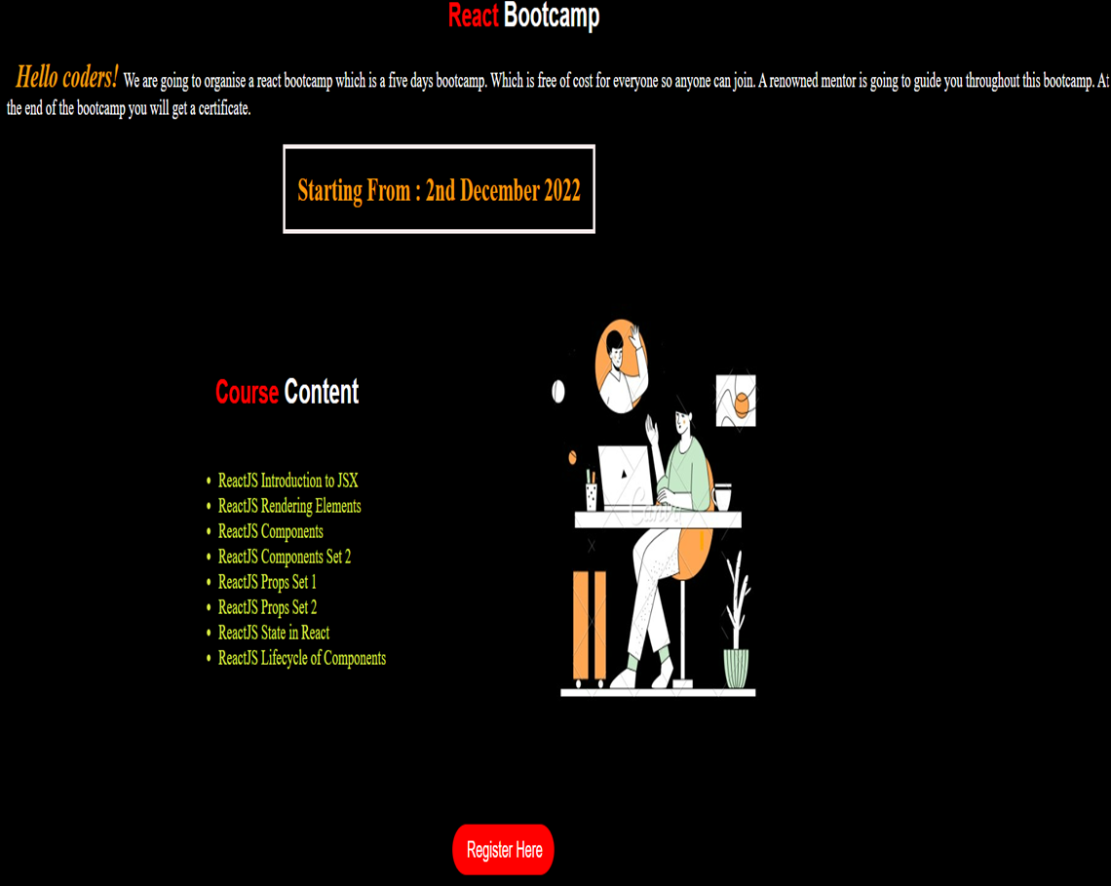
React Bootcamp
Here we have given a brief detail of our ReactBootcamp content .
By clicking on Register Here you can redirect to the registeration page.

Slide 7

Register
In this registration form users need to fill up
their credentials .
In this registration form user details will be
saved in the firebase which is being used as a
backend platform.

Slide 8
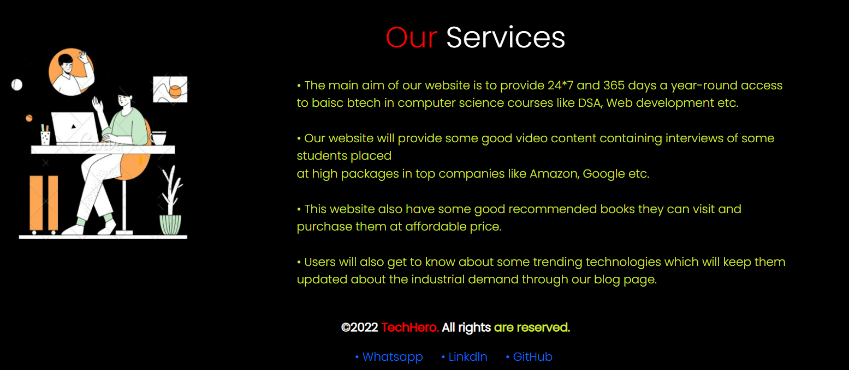
Our Services
This is our Services section which sums up some of our services which are available for the users like 24*7 and 365 days access to the courses and the bootcamps on various technologies .
User can also maintain their list of task through our to-do list section.
We have recommended some books of various technologies.

Slide 9
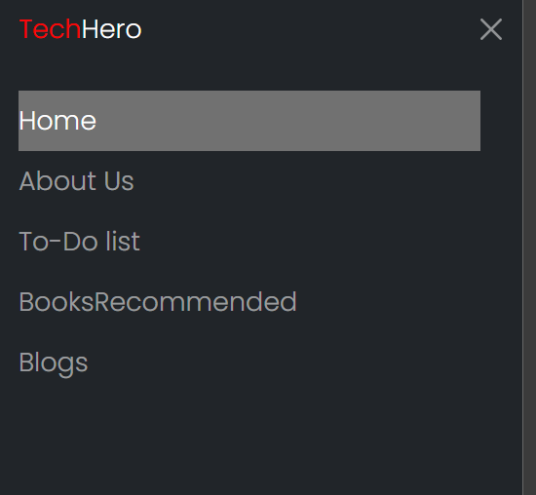
Navigation Bar
This is our menu bar through which user can navigate through various pages.
In this we have added home page, about us , to-do list , books recommended and blogs pages.

Slide 10
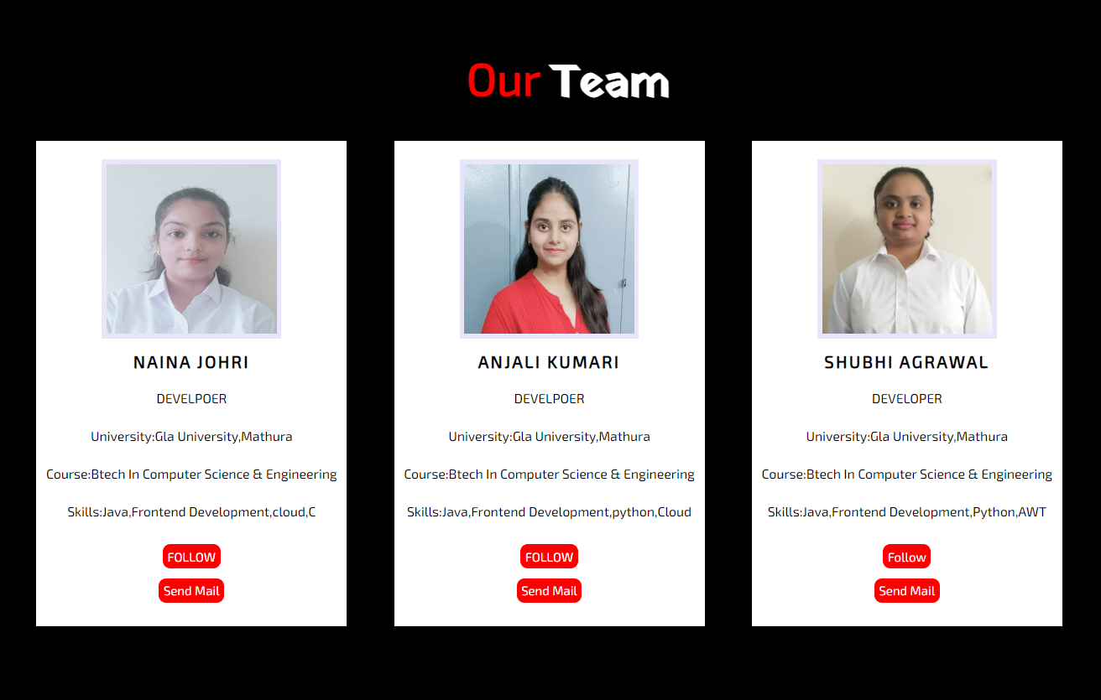
Our Team
This is our team page which will help the users to connect with the people behind this website and also get to know more about the various technical things.
If any problem is faced by the users they can also connect with the developers through this page.

Slide 11
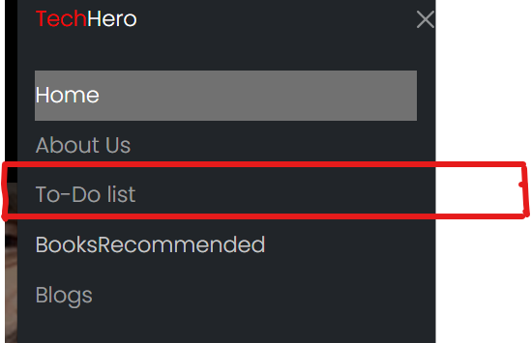
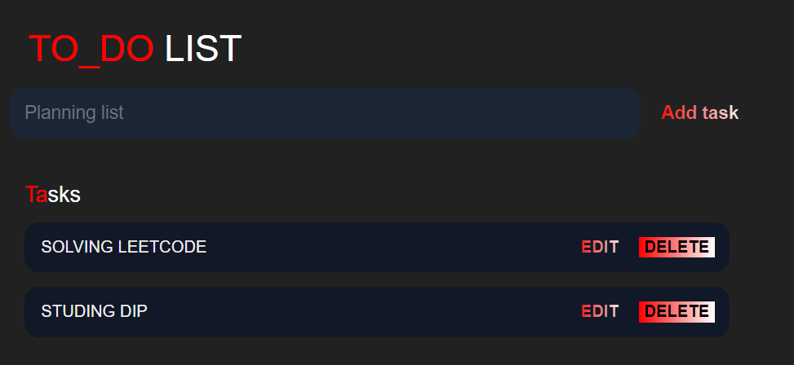
To-Do List
This is the to-do list section users can maintain their daily study schedule which will help them to maintain the consistency in their studies as they will have all their task at one place.

Slide 12
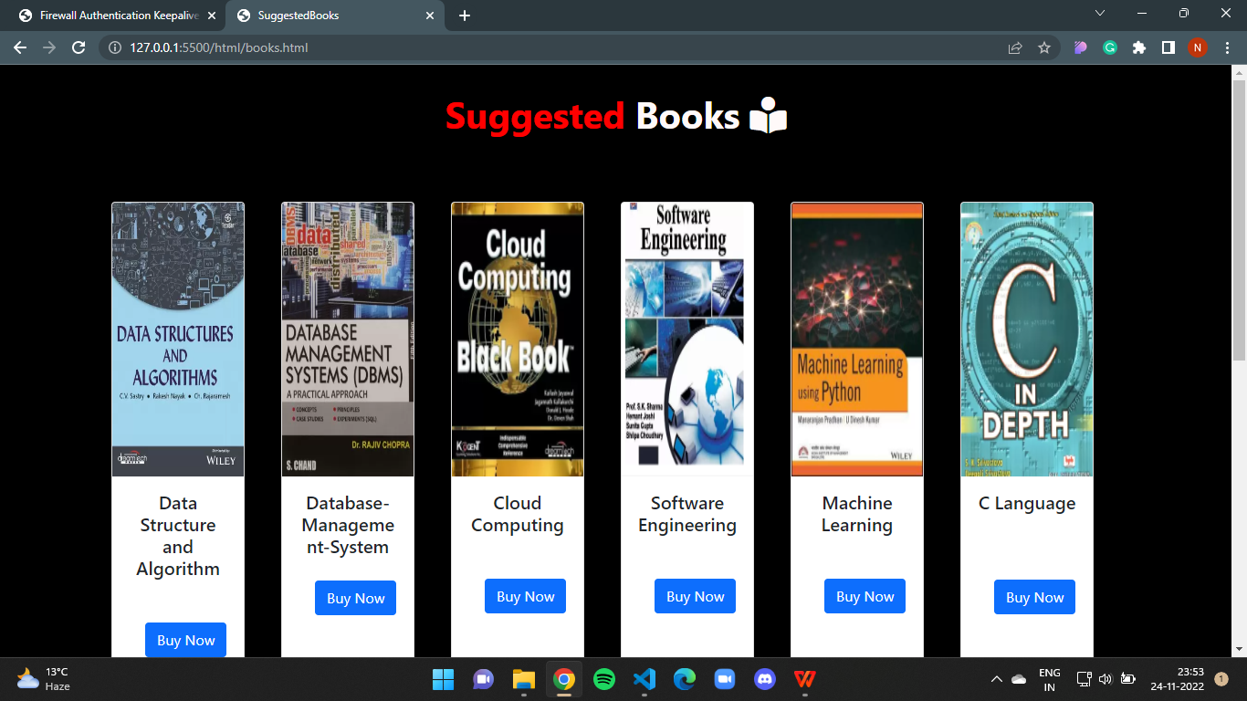
Suggested Books
This is the books recommended page where users can get some awesome books at affordable price .
These are the books which have been recommended by the people who have followed them.

Slide 13
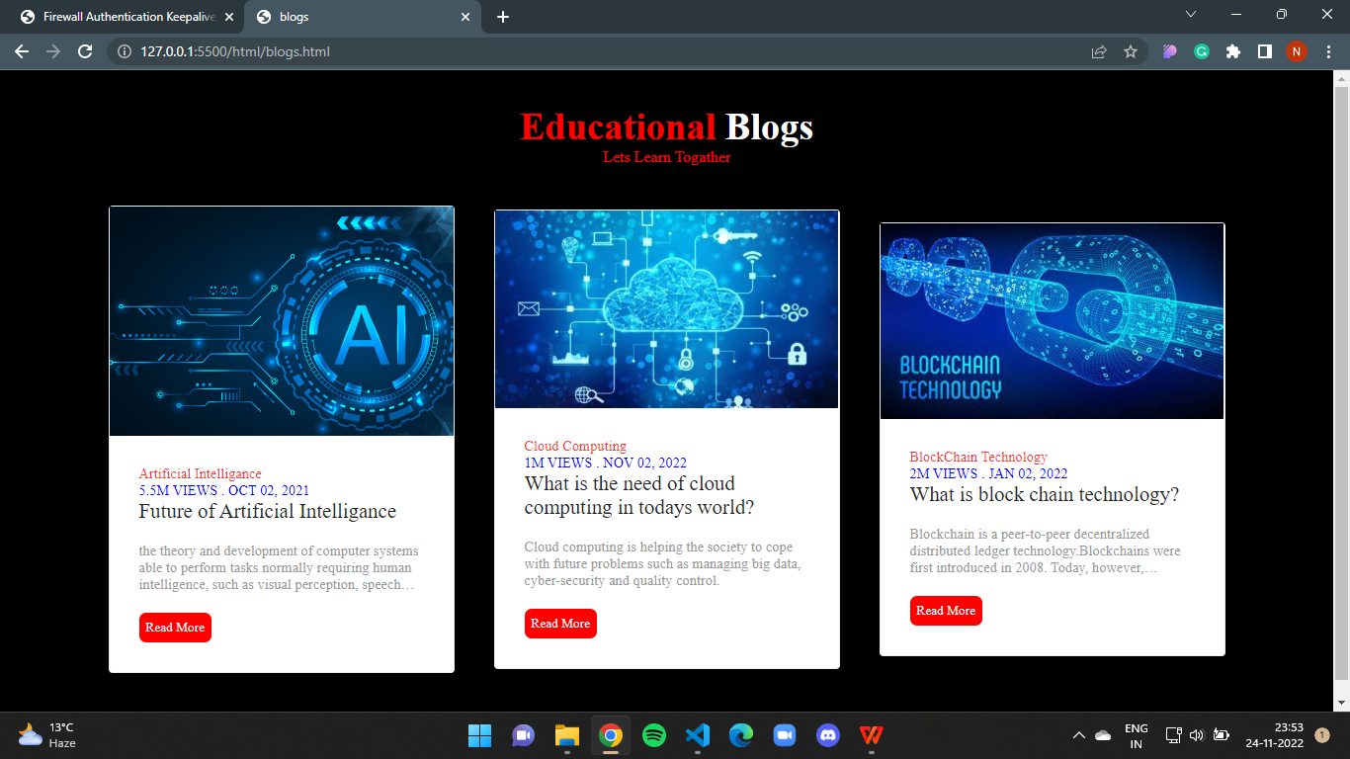
Educational Blogs
This is the page containing blogs having some technologies which are in high demand in the industry. Users can read more about these technologies.

Slide 14

References-
www.geekforgeks.com
www.javatpoint.com
www.w3schools.com
Faculty Guidence-
Md Farmanul Haque(Technical Trainer)

